Slide 1
Smart Surveillance System
Submitted by:
Arsh Singh
Utkarsh Sharma
Vishal Deswal
Rishabh Gupta

Slide 2
Introduction
As we know surveillance is becoming increasingly important in any public or private environment as a result of an increasing number of risks. Smart Surveillance is a software which has various security tools embedded in it. Closed-circuit television (CCTV) cameras or wireless sensor networks (WSN) are the most common traditional monitoring technologies. In this project, we combined the advantages of the two technologies to build a smart surveillance system. It has features like:
Anti-theft
Visitor
Normal Recording
Face Identification
Restricted area

Slide 3
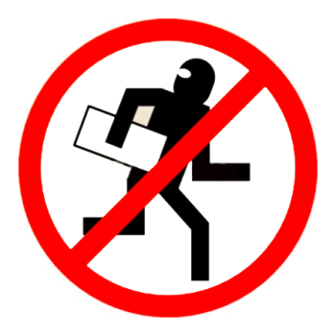
Anti-Theft:
This feature is used to find what is the thing which is stolen from the frame which is visible to the webcam. Meaning It constantly monitors the frames and checks which object or the thing from the frame has been taken away by the thief.

Slide 4

Visitors:
This is the feature which can detect if someone has entered the room or went out.

Slide 5

Normal Recording:
This is the feature which will record the video using the webcam and will save to the external storage.

Slide 6

Face Identification:
This feature is very useful feature of our project, It is used to find if the person in the frame is known or not. It do this in two
steps :
1 – Find the faces in the frames
2 – Use LBPH face recognizer algorithm to predict the
person from an already trained model.

Slide 7

Restricted Area:
This feature is used to detect the motion in a restricted area where human intervention is prohibited.

Slide 8
Requirements:
Software Requirements:
○ Python 3. x
○ Tkinter
○ OpenCV
○ Pillow
○ SQLite3
Hardware Requirements:
○ HD Camera
○ 4 GB RAM
○ 100 GB ROM
○ OS: Windows 7 or higher, Linux (Mac not supported for now)
○ Internet Access

Slide 9
Limitations:
Upgradation in any technology might be incompatible with the dependencies which will result in fallacy.
Lighting conditions could influence the efficiency of system.
The software tends to stop after detecting theft of a single item, it is supposed to be configured again for any further security of the valuables.
Right now it only works with one camera port.

Slide 10
What’s next?
Login Via QR Code and Face Recognition
Alert Message On Phone Number and Email upon theft
Train Model For Knives, fireArms etc.
Integration with IoT devices

Slide 11
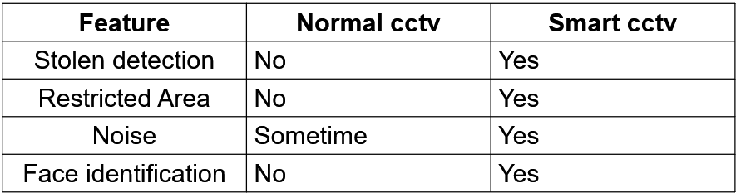
Conclusion

